Slide 1
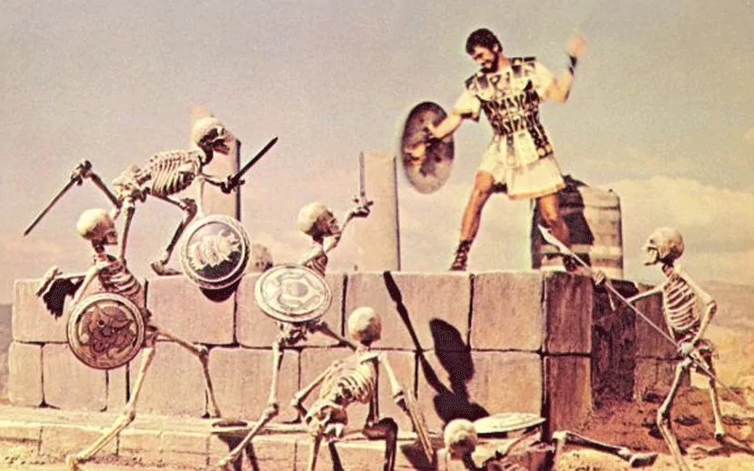

Microfluidics Image Processing
Camera and the Micronauts:
Josh Wildey
Shane Mccormack
Honghao Zheng
Josh Lippai
Notes:
‹#›

Slide 2
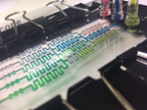
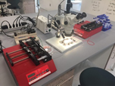
Goals and Motivation
Microfluidics Image Processing
EC 551 April 25, 2018
Implement real-time moving droplet detection for video on an FPGA
Ideally, faster than previously implemented software solutions for this problem
Implement real-time feedback/output in response to these detections
‹#›
Notes:
‹#›

Slide 3
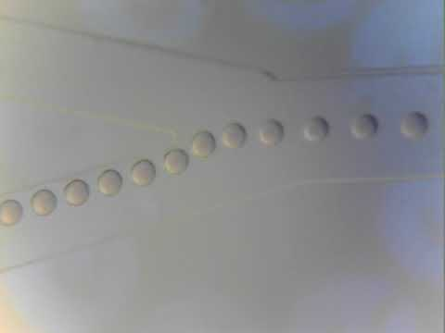
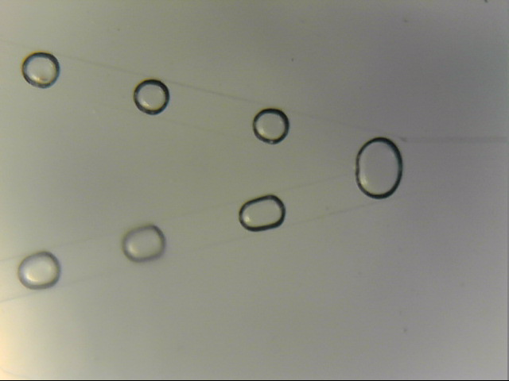
Goals and Motivation
Microfluidics Image Processing
EC 551 April 25, 2018
‹#›
Notes:
‹#›

Slide 4
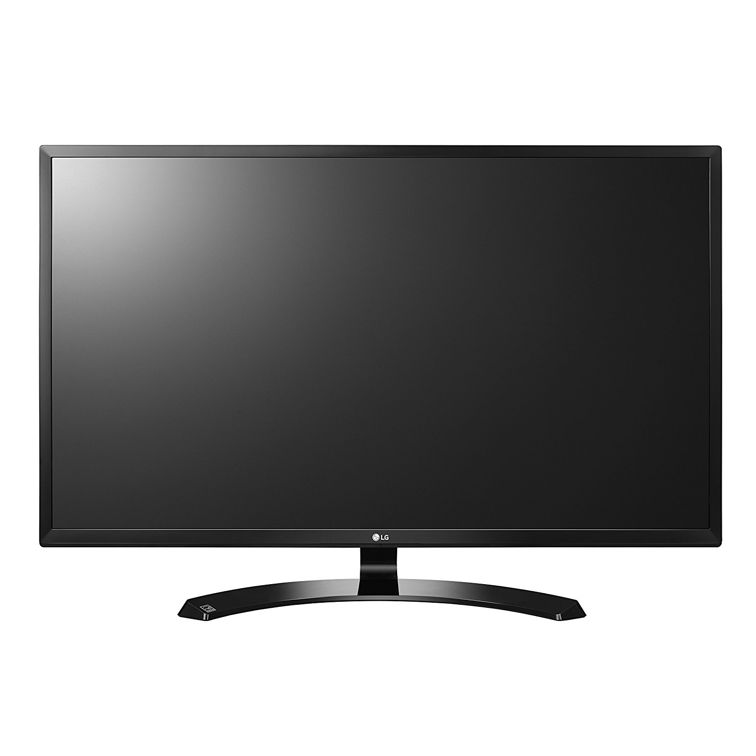
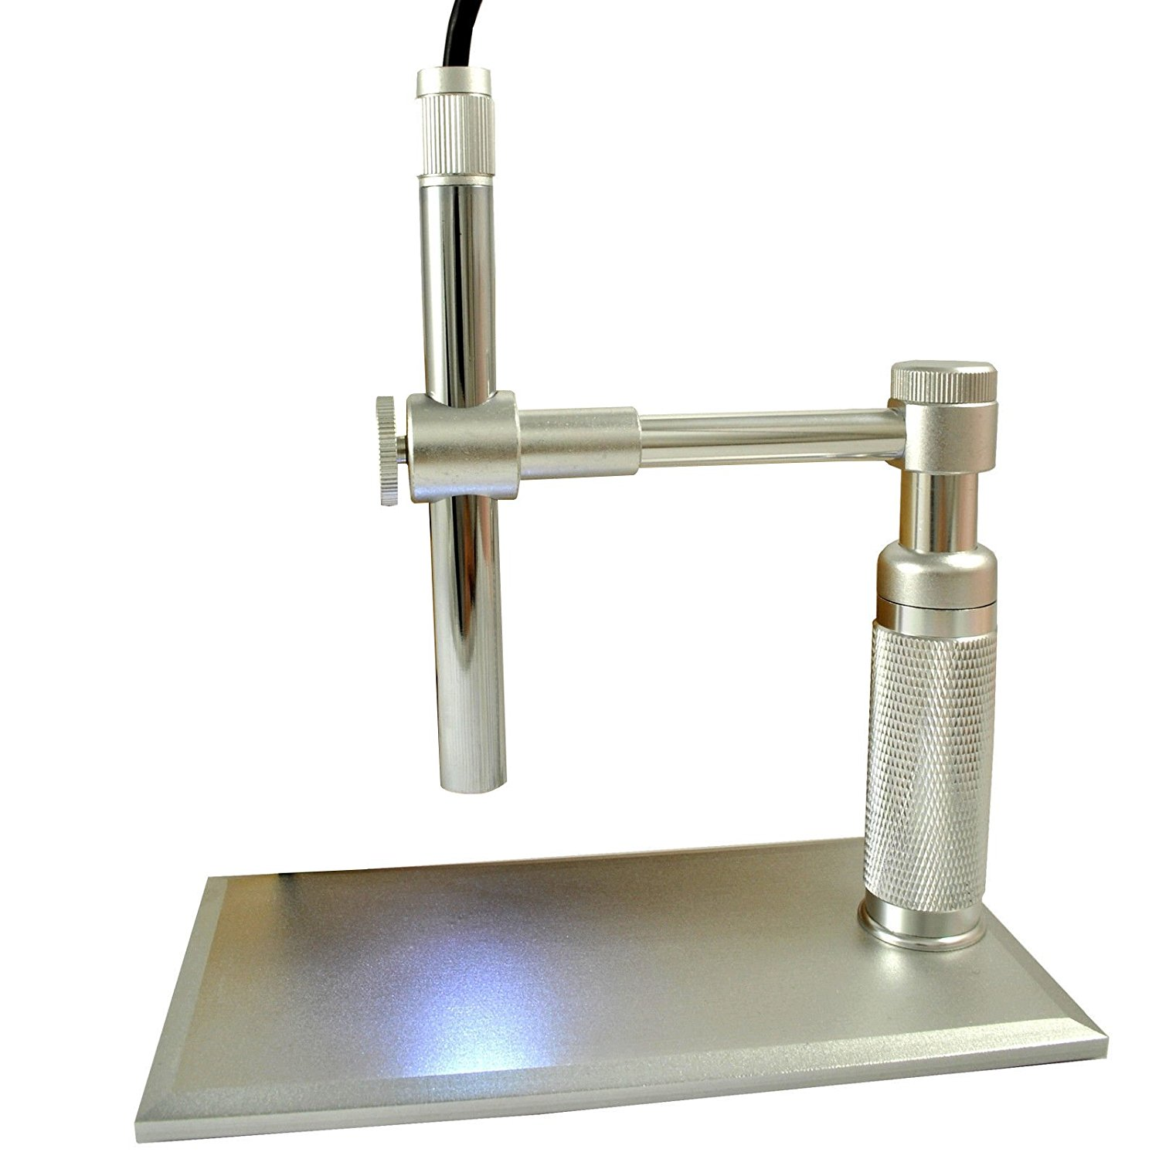
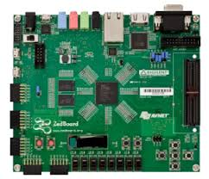
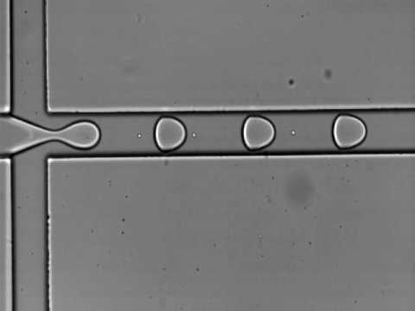
Short Functionality
Microfluidics Image Processing
EC 551 April 25, 2018
Camera
Zedboard
Good: 1
Bad: 0
‹#›
Notes:
‹#›

Slide 5


Short Specification
Microfluidics Image Processing
EC 551 April 25, 2018
Take video frame in
Detect droplets
Tell “good” from “bad”
Trigger signal (just counters for now)
“Fast enough” → >1 Hz or ideally 15 Hz since 30 fps.
‹#›
Notes:
‹#›

Slide 6
Detailed Block Diagram
Microfluidics Image Processing
EC 551 April 25, 2018
Zedboard
Flash/SD Card (OS)
APB-32 Bit
Zynq-7000
ARM
AXI 64 Bit
Central
Interconnect
USB
Camera
AXI 32/64 Bit
Artix-7 FPGA
VGA Ctrl
BRAM
Image
Proc
VGA
Monitor
‹#›
Notes:
‹#›
Final design goals were to interface the camera directly with the ARM processor and the Linux OS and then use the AXI interface to DMA video frames down to the FPGA. FPGA would either double buffer or triple buffer video frames from the DMA to that the image processing would then read and process and results would be display through VGA.

Slide 7
Detailed Description of Modules
Microfluidics Image Processing
EC 551 April 25, 2018
‹#›
Notes:
‹#›
Josh W

Slide 8
Memory Controller
Microfluidics Image Processing
EC 551 April 25, 2018
Utilizes ZedBoard BRAM + LUT memory to store 320x240 video frames
614.4 Kb/frame
4.9 Mb in BRAM
Can hold ~5 video frames + reference frame in BRAM
Dual-port read:
VGA Display
Image Processing
Frame Instances
Frame
Main
Memory
Manager
readBlockAddress [12:0]
Frame
readByteAddress [16:0]
pixBlockRow1 [31:0]
pixBlockRow2 [31:0]
Frame
pixBlockRow3 [31:0]
pixelBlockOut [127:0]
pixBlockRow4 [31:0]
pixBlockRow5 [31:0]
Frame
pixelOut [7:0]
pixelOut [7:0]
Frame
‹#›
Notes:
‹#›
Shane
Utilizing the ZedBoard’s Block Memory, there is enough space to store 5 frames of video and one frame of reference for image processing (more on that later)
The Memory controller has two interfaces, one for VGA and another for image processing. Each module inputs it’s desired read address for a frame of video, and the manager serves up the desired pixel(s)

Slide 9
Memory Controller
Microfluidics Image Processing
EC 551 April 25, 2018
Frame Memory File
Memory File:
Byte (pixel) addressable
VGA output reads pixels in order
17 bit address for pixel addressing
Image processing reads pixels in 4x4 pixel chunks
13 bit address for pixel block addressing
0
320
0
0 | 1 | 2 | 3 | 4 | 5 | 6 | ... | 319
320 | 321 | 322 | 323 | 324 | 325 | 326 | ... | 639
640 | 641 | 642 | 643 | 644 | 645 | 646 | ... | 959
960 | 961 | 962 | 963 | 964 | 965 | 966 | ... | ...
240
‹#›
Notes:
‹#›
Shane
A little more on the memory implementation:
Each frame is ~77KB and the frame file is byte addressable.
The two interfaces, read from VGA and read from image processing read from the file in two separate ways. VGA only needs one pixel at a time and so needs a larger address space to be able to address every byte. Image processing uses 4x4 blocks of pixels, so it requires much less address space, as it only cares about each maroon block in the table above.

Slide 10
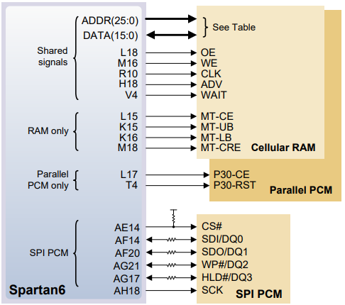
Design Tradeoffs - Memory
Microfluidics Image Processing
EC 551 April 25, 2018
Nexys3
BRAM - not enough
Cellular RAM - too slow, single port
Parallel PCM - too slow, single port
Serial PCM - 1 bit bus
No good options
‹#›
Notes:
‹#›
The Nexys3 did not have enough BRAM to store enough frames of data to be useful. So we spent a lot of time into research other memory options to be able to process entire video frames. We first looked into off-chip cellular RAM on the Nexys3 board which had plenty of storage but the performance was extremely slow. To begin with it had a 16-bit read bus, and it was only single port meaning we could only write OR read at any given time, which leads into the next point, timing. The range of read times of 16 bits was 70-80 ns. With the VGA pixel clock (for 640x480 resolution) at 25 MHz, that was one pixel every 40 ns, which leave ZERO room for error in timing. This would also mean we could only read from Cellular RAM because all of the time would go to continuously reading with no time to write the data coming from the camera to the memory.
The two other options on the Nexys3 board, parallel interface memory with similar limitations as the Cellular RAM and the Serial RAM with a serial interface which would have even slower performance since it only operated on 2 lines. Since we didn’t have enough BRAM we couldn’t buffer frame data either so there were no memory options on the Nexys3.

Slide 11
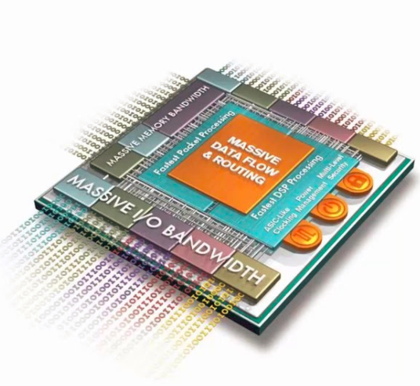
Design Tradeoffs - Memory
Microfluidics Image Processing
EC 551 April 25, 2018
Zedboard
Block RAM/LUTs
Enough space for video frames at lower resolution
Much faster than off-chip memory
True read/write dual port
‹#›
Notes:
‹#›
Shane
The Zedboard provided more BRAM to store multiple frames at a lower resolution. This provided the option to make our own true dual port RAM to read/write to multiple locations asynchronously.

Slide 12
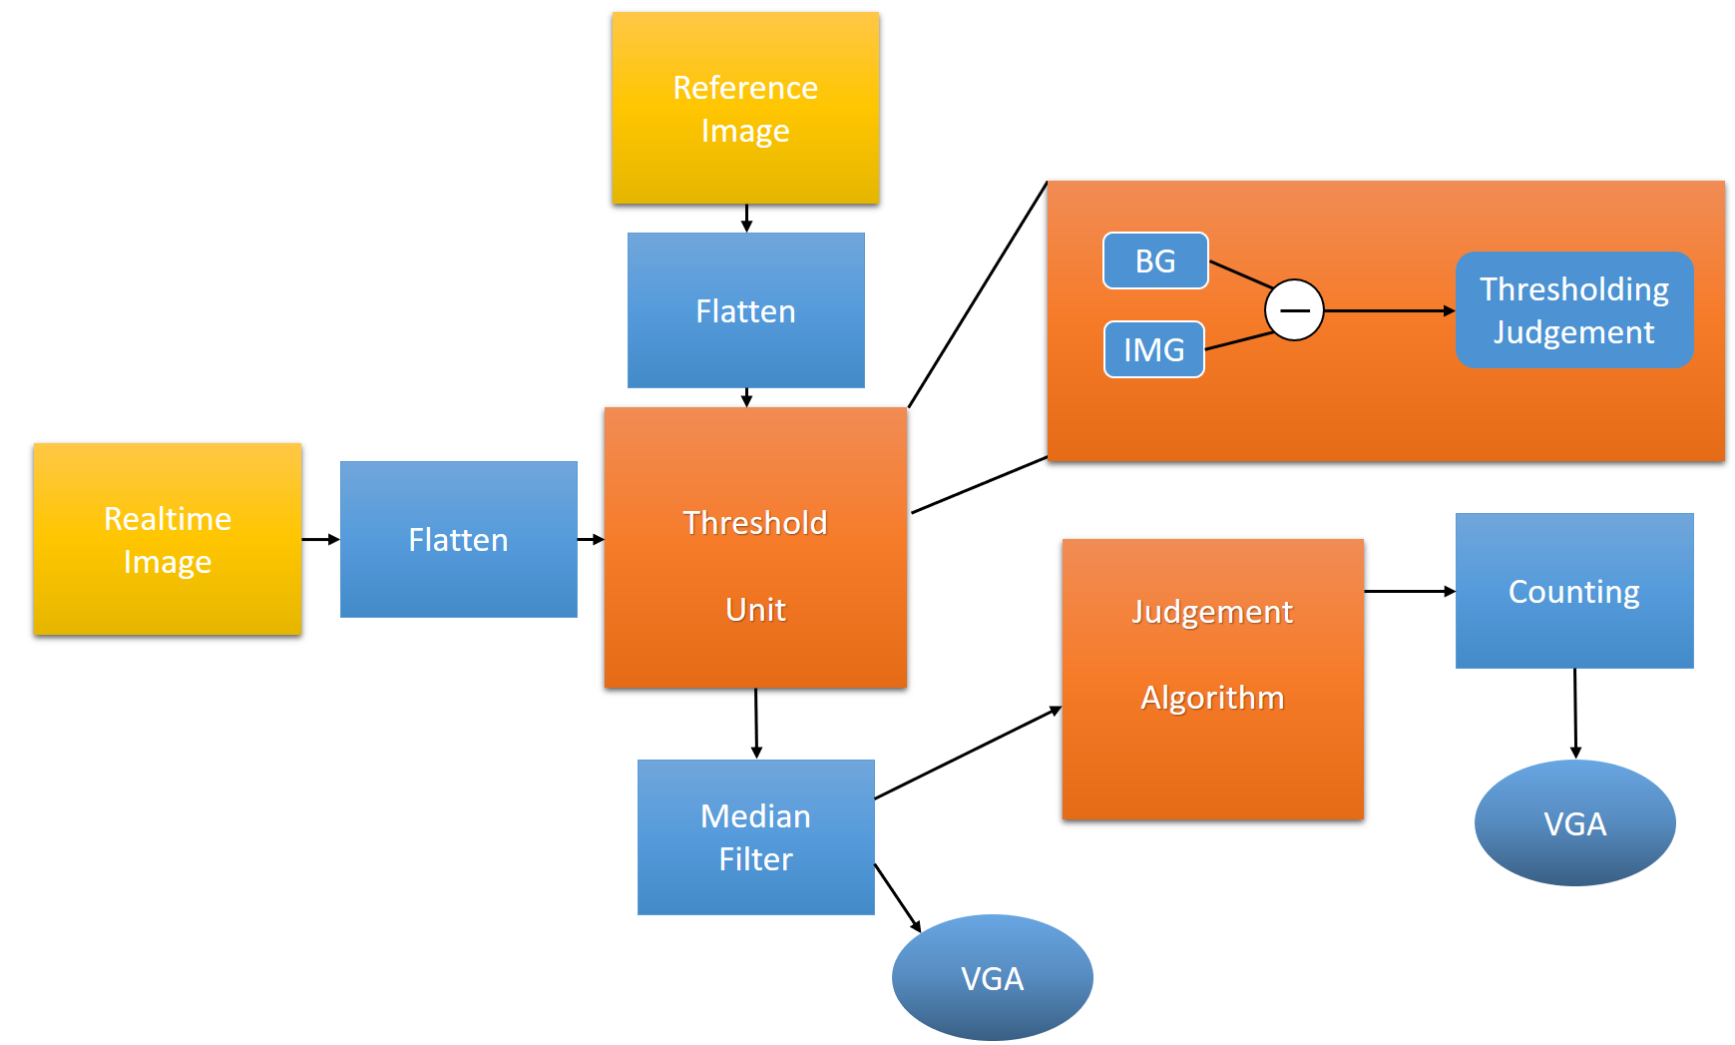
Image Processing Block Diagram
Microfluidics Image Processing
EC 551 April 25, 2018
‹#›
Notes:
‹#›

Slide 13
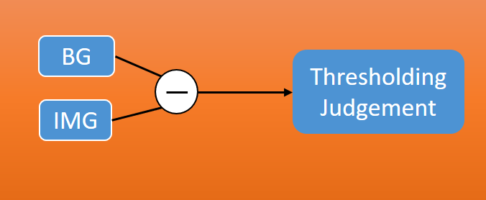
Thresholding
Microfluidics Image Processing
EC 551 April 25, 2018
Requires three pieces of information:
Current frame (all pixels)
Reference background frame (all pixels)
Future: Weighting information (for all pixels)
‹#›
Notes:
‹#›

Slide 14
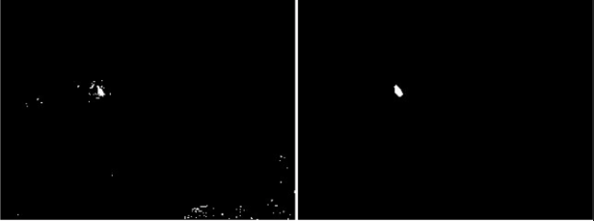
Median Filter and Judgment
Microfluidics Image Processing
EC 551 April 25, 2018
Problem with thresholding: Noisy Images
How to solve: Median Filter!
Why Median Filter?
Removes outliers
But preserves edges/overall shape
Widely used in image processing
Filtered image is then checked for intersection with line of crossing
[7]
‹#›
Notes:
‹#›

Slide 15
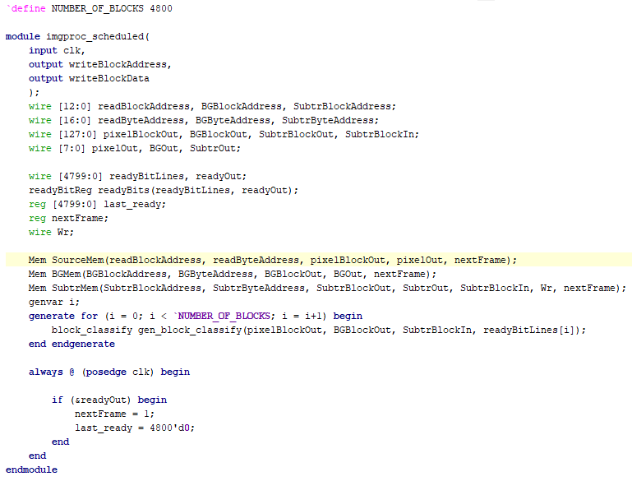
Verilog Example
Microfluidics Image Processing
EC 551 April 25, 2018
Reading data
Multiple instantiation of block ops
nextFrame lets mem know to read next
‹#›
Notes:
‹#›

Slide 16
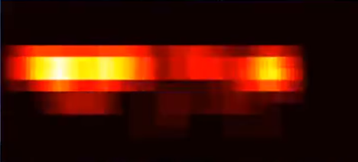
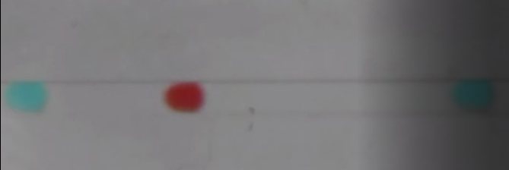
Design Tradeoffs - Image Processing
Microfluidics Image Processing
EC 551 April 25, 2018
Denoising
Since intention is to use with video, could use video techniques for better accuracy
Purely image-based techniques are less reliable in video context, but faster
‹#›
Notes:
‹#›
Obj recognition requires denoising to remove outliers
Since we are using video, there are tools available to us that take advantage of frame-to-frame object permanence but they require a buffer
We do not use this because of our goal to optimize for fps and memory constraints, but with a faster camera this could be preferable

Slide 17
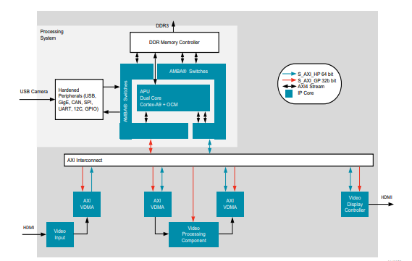
Design Tradeoffs - Image Processing
Microfluidics Image Processing
EC 551 April 25, 2018
Pure PL vs. IP Core and SoC
Zedboard has HLS and can integrate SoC with FPGA
Future iterations will probably do this
Current implementation is done entirely in PL
Potentially more efficient
Makes interfacing with peripherals a pain
‹#›
Notes:
‹#›
Background subtraction generally follows the same structure across implementations as discussed earlier
But for droplet detection, it may have made just as much sense to go with an ML/classification approach - this is very accurate and, leveraging IP cores/DSP slices, pretty fast as well
Looked into this, but additional data needs to be stored for this, such as bounding box info and a lot more training data

Slide 18
Display Interface
Microfluidics Image Processing
EC 551 April 25, 2018
1400 x 1050 resolution
Originally intended to use higher resolution video frames
Sprite based design to show video feed and counter
Counter originally was going to be on 7-Segment using buttons to switch between good and bad droplet counters.
Zedboard doesn’t have a 7-segment, so we opted to display on monitor
clk
main
rst
VGA Controller
hcnt [11:0]
vcnt [11:0]
hsync
vsync
vid_active
clk
display
rst
clk
disp_char
pixelCol [11:0]
rst
pixelRow [11:0]
char_sel [4:0]
vid_en
char_row [5:0]
goodDrops [15:0]
char_col [5:0]
badDrops [15:0]
pixel_en
blue [3:0]
green [3:0]
red [3:0]
frPixAddr [16:0]
frPix [7:0]
logoPixAddr [16:0]
logoPix [7:0]
‹#›
Notes:
‹#›
VGA controller comprised of 3 files connected through main. VGA controller that controls the pixel clock, HSYNC, VSYNC. Display module controls the sprites, one for the video frame, one for the logo frame, and lastly for the counter text block. The Display module will use the pixelCol and pixelRow to calculate which area of the screen we’re in to determine whether or not to display something.
Zedboard has an OLED display that we could have used to display counter but it would not have been as clean to display and would need more peripherals. OLED display also works with a serial communication protocol which seemed unnecessary to implement.

Slide 19
Display Interface
Microfluidics Image Processing
EC 551 April 25, 2018
Pixel row/col
Good: 1
Bad: 0
Which
Sprite?
Camera Frame
Logo
Counter
Text
Calculate
Pixel
Address
Calculate
Which Char
To Display
G | O | O | D |  | : |  | # | # | # | # | #
 | B | A | D |  | : |  | # | # | # | # | #
Read pixel & convert to 12-bit color
Pixel on/off
Pixel Out
‹#›
Notes:
‹#›
Monitor to display video frame sprite, logo sprite and text area sprites. Incoming pixel row/column counts from VGA controller will be used to determine which sprite to display and the pixel address necessary to access it from memory. Video frames are currently stored in 8 bit color (3 red, 3 green, 2 blue) which is converted up to 12 bit color that the Zedboard uses (4 for each). Text displayed in all white on black background.

Slide 20
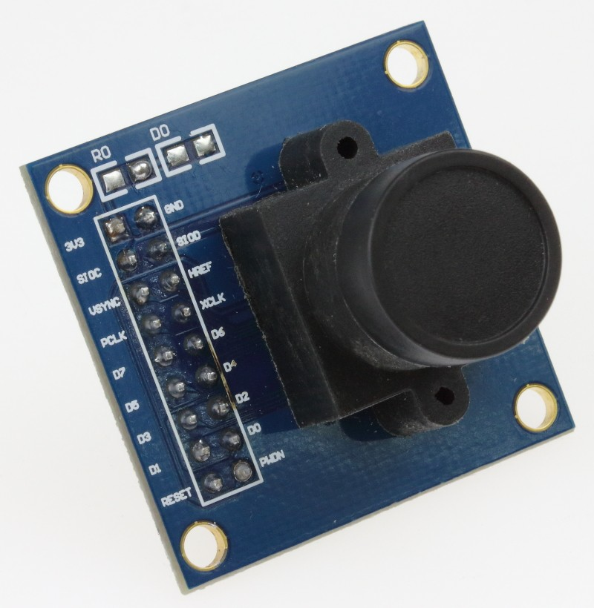
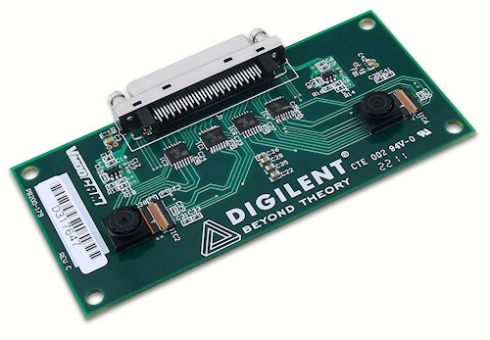
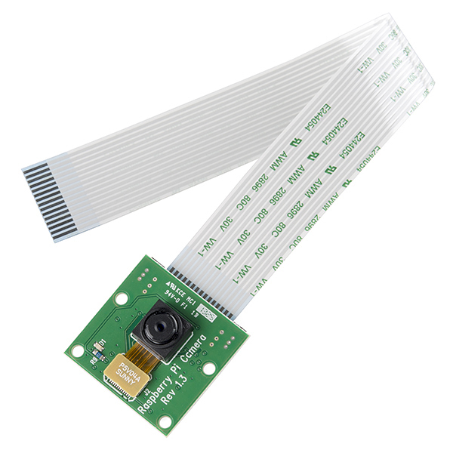
Design Tradeoffs - Camera
Microfluidics Image Processing
EC 551 April 25, 2018
Multiple Camera Options
Omnivision OV7670 Camera
Proprietary communication protocol
Previous project tried VModCam
Did not have access to this camera, only for Nexys3
Raspberry Pi Camera
CSI-2 Interface (proprietary)
Either, reverse engineer or buy license for IP
With IP, could hook camera directly up to FGPA
Opti-Tekscope Digital Microscope Camera
Advantage of zoom imaging
USB interface, we assume it adheres to USB Video protocol
Found USB IP, but do not know if the IP adheres to USB Video protocol
‹#›
Notes:
‹#›
Omnivision camera decided on early on to not use because of communication protocol. Same with VModCam since we didn’t have one. VModCam also only for Nexys3 which we are not using due to BRAM limitations
Raspberry Pi Camera - found a draft specification and started implementing the protocol. It uses I2C for configuration, which was implemented, which would have been easy to use to configure resolution and color settings of camera. Implemented physical layer of the CSI-2 camera interface from draft specification that worked in simulation. Started implementing lane management layer, but draft specification was missing some details.
Opti-Tekscope Camera - could not find spec sheet for it, so assume that it adheres to USB Video specification. May have proprietary settings for zoom, but unsure. Found open source USB 2.0 core but do not know if that adheres to the USB Video specification. Did not have enough time to read through USB core code to see if it would work for us.

Slide 21
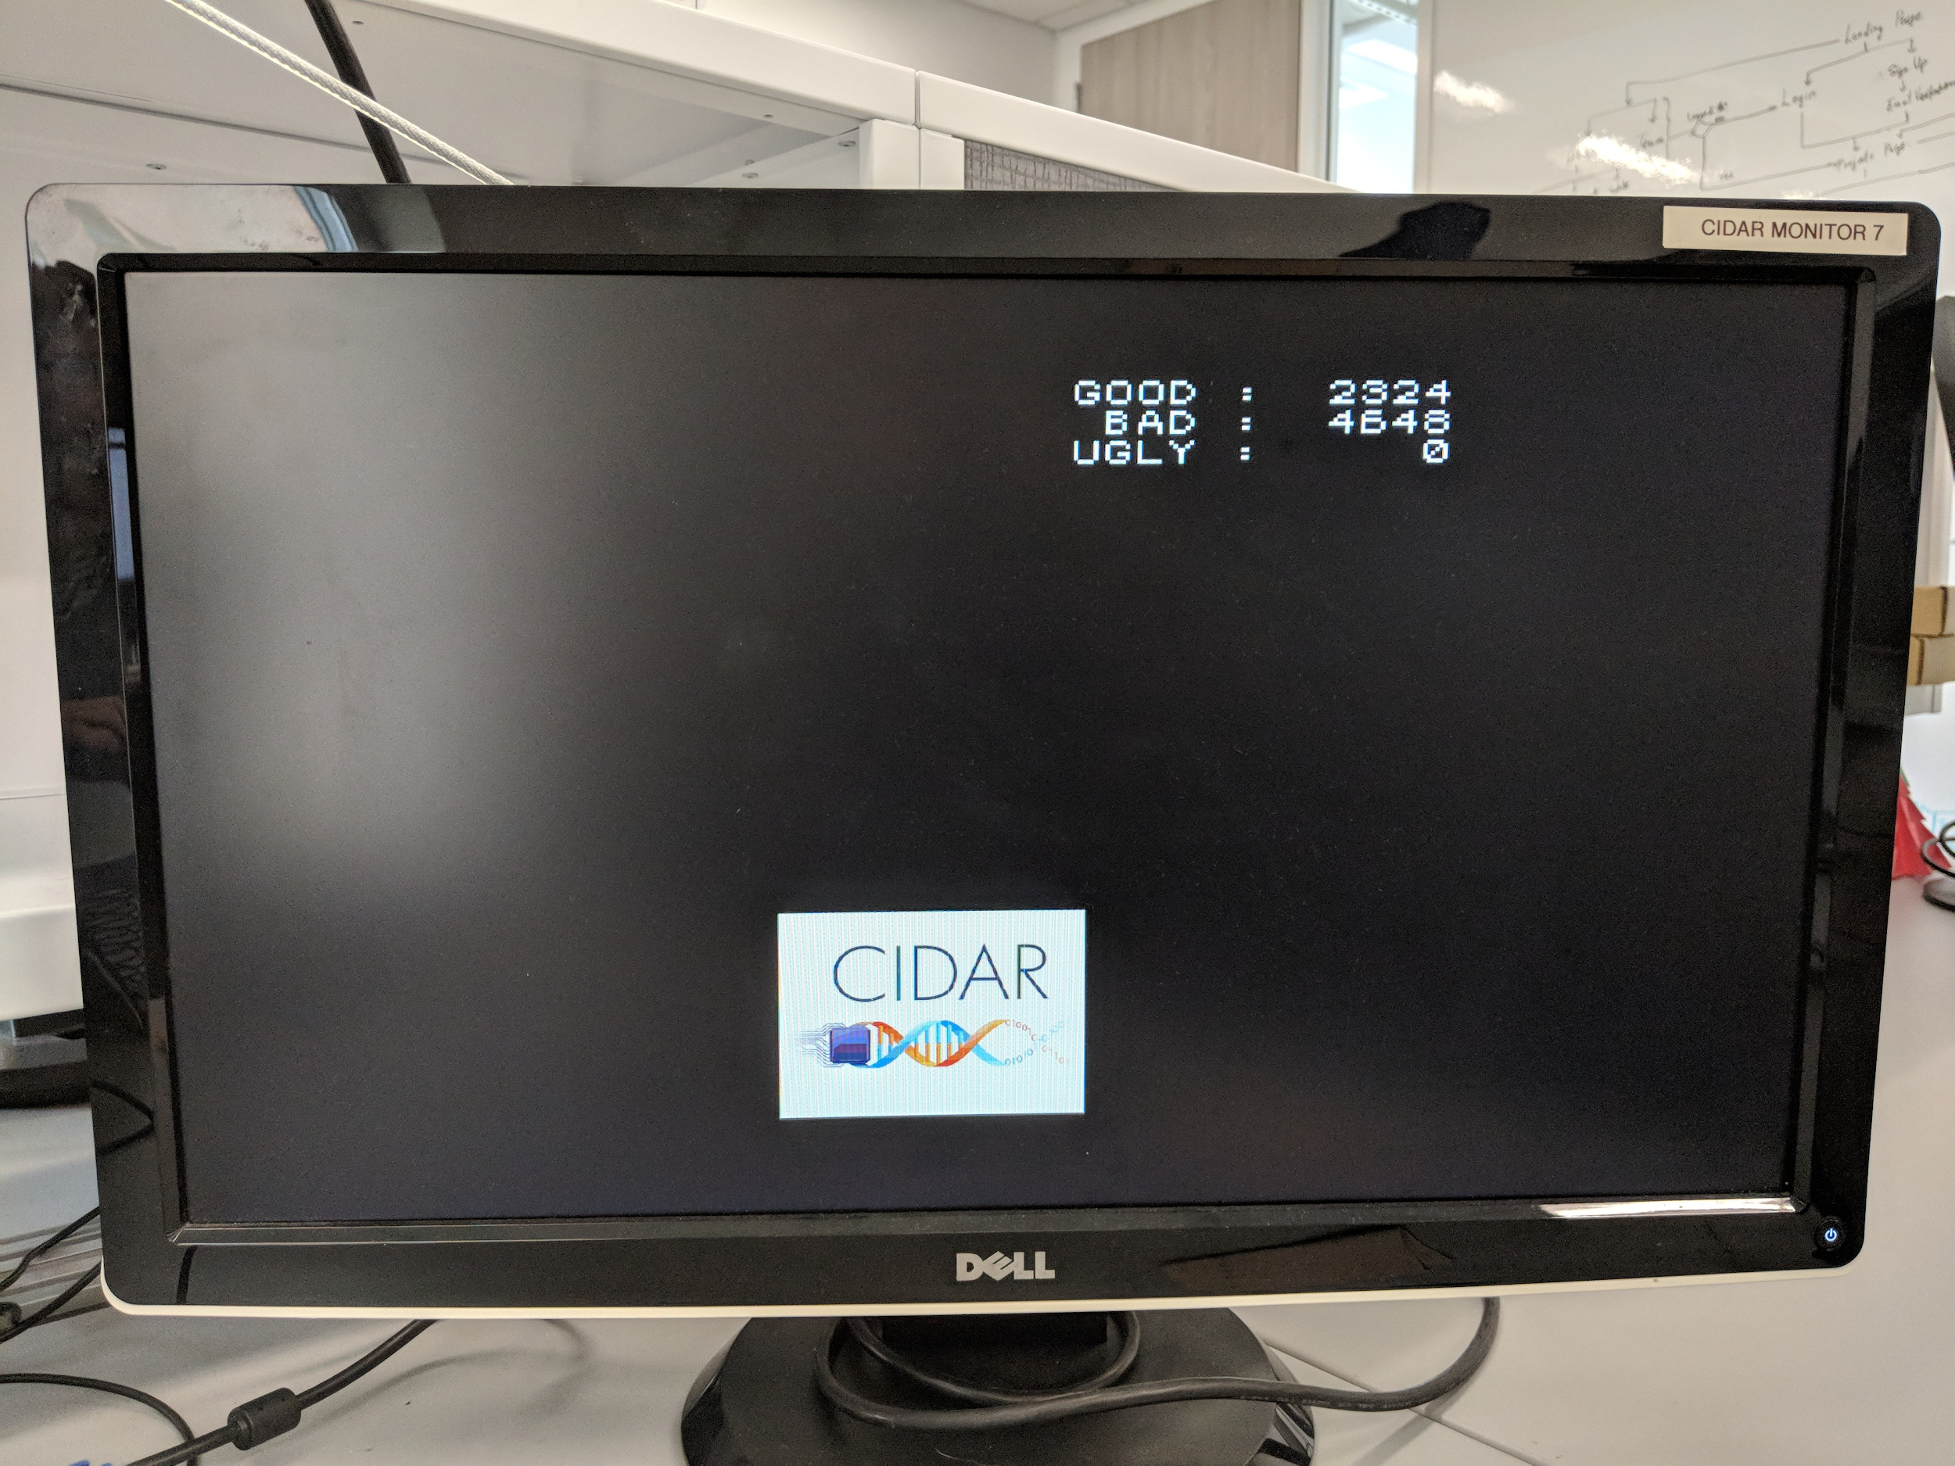
Success
Microfluidics Image Processing
EC 551 April 25, 2018
Interfaced the VGA output and display the counting of droplet on the monitor.
Display image frame on monitor
Integrated VGA with memory
Currently integrating memory interface with image processing
‹#›
Notes:
‹#›

Slide 22
Failure
Microfluidics Image Processing
EC 551 April 25, 2018
Unable to interface camera directly to FPGA.
Raspberry Pi Camera interface require $4000 license (or reverse engineered CSI-2 interface)
Not enough time interface USB camera through Linux OS
‹#›
Notes:
‹#›

Slide 23
Work Attribution
Microfluidics Image Processing
EC 551 April 25, 2018
Josh L – Image Processing
Honghao – Image Processing
Josh W – Display Interface, Camera, Memory Tradeoff Study
Shane – Memory Controller, Memory Tradeoff Study
‹#›
Notes:
‹#›

Slide 24
Future Goals
Microfluidics Image Processing
EC 551 April 25, 2018
Demo Day
Finish image processing/memory integration
Run background subtraction on captured droplet video frames and display results
Benchmark image processing
Further down the line
Camera interface (proprietary license/HDMI input)
Support for higher resolution video (more memory for memory interface/reduce color fidelity)
‹#›
Notes:
‹#›

Slide 25
References
Microfluidics Image Processing
EC 551 April 25, 2018
[1] Nexys3 Reference Manual https://reference.digilentinc.com/_media/nexys:nexys3:nexys3_rm.pdf
[2] Raspberry Pi2 Schematic https://www.raspberrypi.org/documentation/hardware/raspberrypi/schematics/rpi-3bplus_reduced_schematic.pdf
[3] Sony IMX219 Datasheet https://github.com/rellimmot/Sony-IMX219-Raspberry-Pi-V2-CMOS/blob/master/RASPBERRY%20PI%20CAMERA%20V2%20DATASHEET%20IMX219PQH5_7.0.0_Datasheet_XXX.PDF
[4] CSI-2 Specification (Camera Serial Interface) http://electronix.ru/forum/index.php?act=Attach&type=post&id=67362
[5] I²C Specification https://www.nxp.com/docs/en/user-guide/UM10204.pdf
[6] Cellular Memory Specification
http://www.stm32circle.com/resources/Datasheets/16mb_burst_cr1_0_p23z.pdf
[7] Willem W. Verstraeten, Bart Vermeulen, Jan Stuckens, Stefaan Lhermitte, Dimitry Van der Zande, Marc Van Ranst and Pol Coppin. “Webcams for Bird Detection and Monitoring: A Demonstration Study.” Sensors, 2010.
[8] Zedboard Technical Specification
https://www.xilinx.com/support/documentation/user_guides/ug585-Zynq-7000-TRM.pdf
‹#›
Notes:
‹#›

